Slide 1
Web Engineering
Javascript Regix Validation

Slide 2
Javascript Regix Validation
Regular Expressions, commonly known as "regex" or "RegExp", are a specially formatted text strings used to find patterns in text. Regular expressions are one of the most powerful tools available today for effective and efficient text processing and manipulations. For example, it can be used to verify whether the format of data i.e. name, email, phone number.

Slide 3
Javascript Regix Validation
The regular expression consists of a pattern enclosed between slashes /. For example,
var regularExp = /abc/;

Slide 4
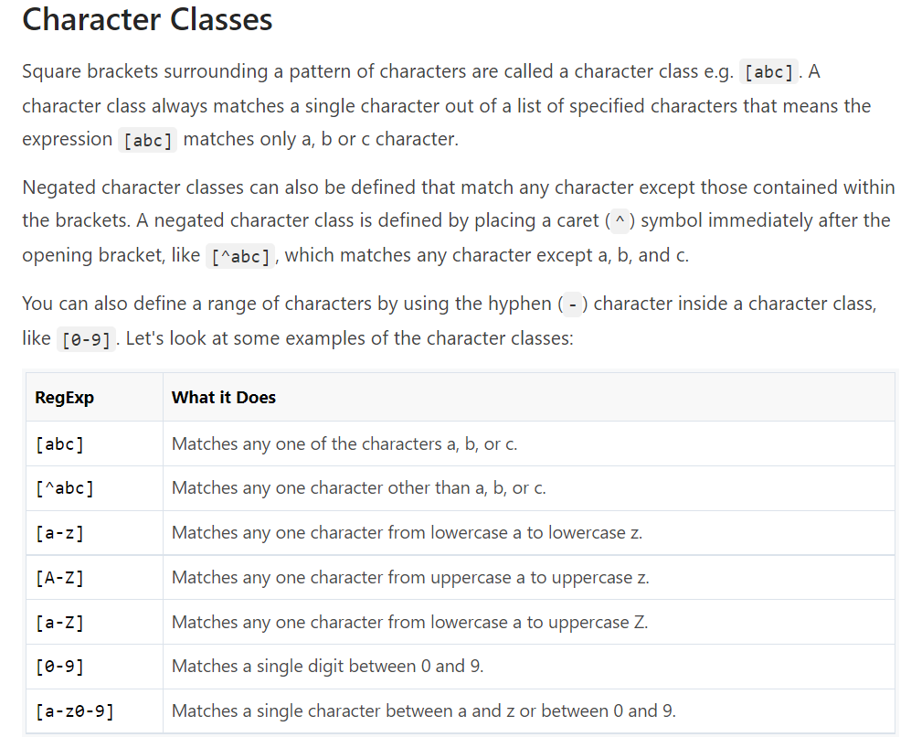
Javascript Regix Validation

Slide 5
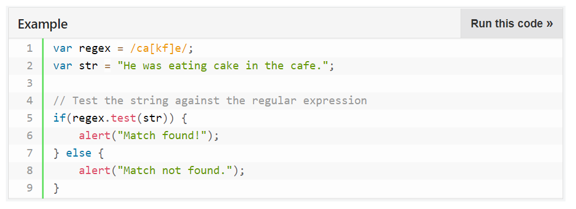
Javascript Regix Validation

Slide 6
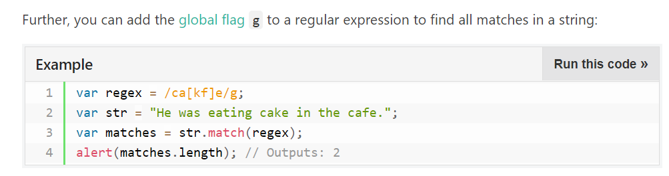
Javascript Regix Validation

Slide 7
Javascript Regix Validation
MetaCharacters
Metacharacters are characters that are interpreted in a special way by a RegEx engine. Here's a list of metacharacters:
. * ? + [ ] ( ) { } ^ $ | \

Slide 8
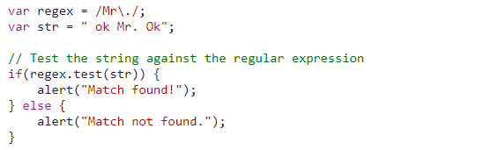
Javascript Regix Validation

Slide 9
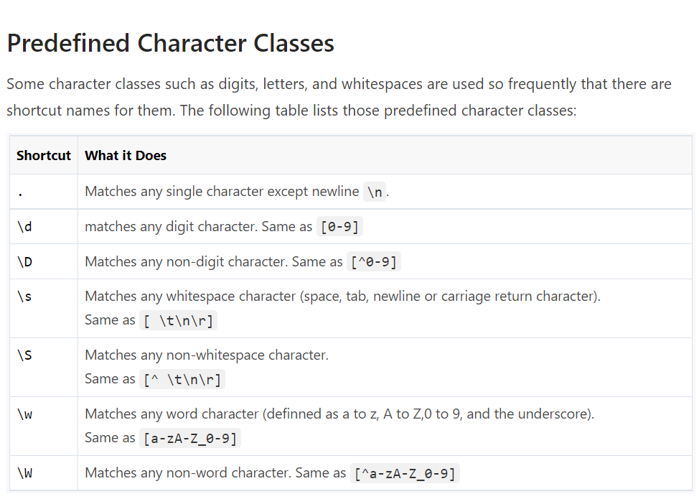
Javascript Regix Validation

Slide 10
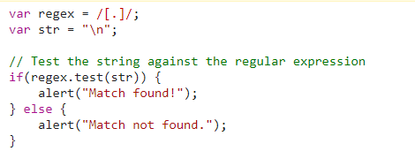
Javascript Regix Validation

Slide 11
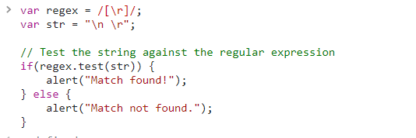
Javascript Regix Validation

Slide 12
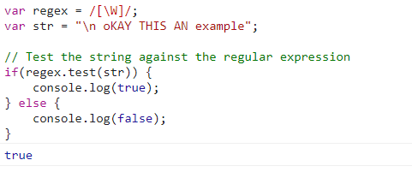
Javascript Regix Validation

Slide 13
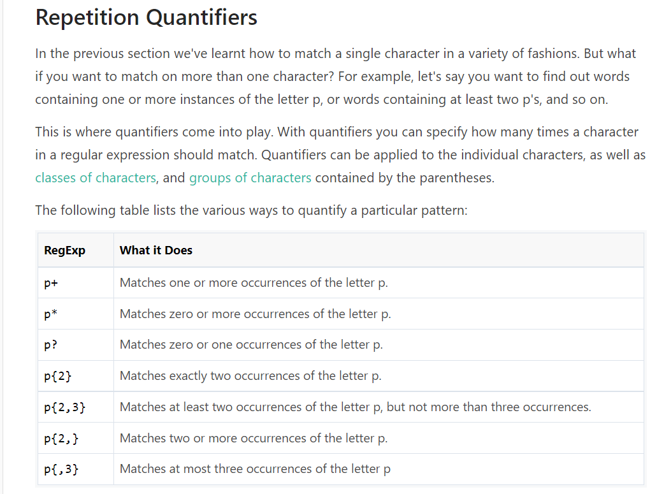
Javascript Regix Validation

Slide 14
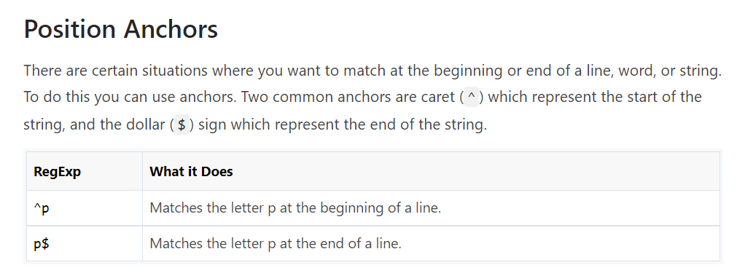
Javascript Regix Validation

Slide 15
Practise Examples Validation
(A) Mobile number that starts with 8 or 9 and total number of digits are 10.
(B)Write a regix starts with Upper case and end with lower case ,in between only one numeric digit is allowed,length of characters is not limited.Valid string is ‘Testing2dasa’
(C) Regix Operation for only Emails , Example of valid string is Arham@gmail.com

